Slide 1

ASURE
AUTONOMOUS INSURANCE
@ETHBerlin hackathon DEZENTRALIZED PENSION SYSTEM
www.asure.io

Slide 2
WHY? AND WHY DECENTRALIZED PENSION SYSTEM?
We want to improve people lives
Many industrial countries are in trouble
Globalization
decentralization and crypto is awesome!!!
Notes:
- you can‘t work your whole life
- demography

Slide 3
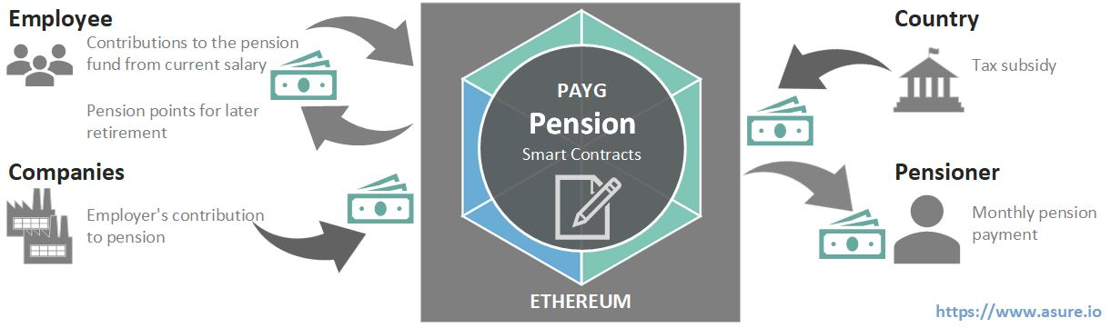
PAYG / Redistribution Scheme
Pros
Inflation save
Connected to current salaries
Government protects you against risks
Cons
Must be mandatory
Idea
Tokenization of pension points => DECENTRALIZED PENSION TOKEN (DPT)

Slide 4
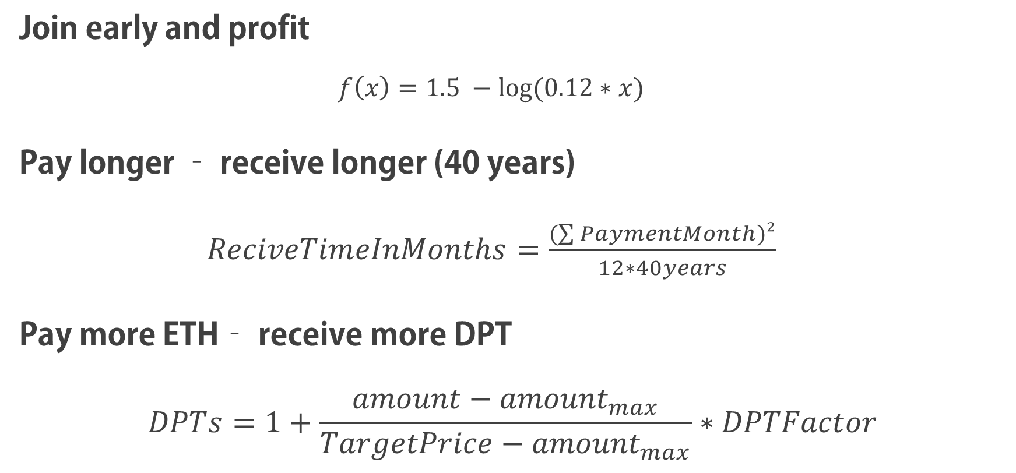
INCENTIVATION MODEL
Join early and profit
$$f\left(x\right)=1.5 −log⁡(0.12∗x)$$
Pay longer – receive longer (40 years)
$ReciveTimeInMonths=\frac{(\sum{PaymentMonth})²}{12∗40years}$
Pay more ETH– receive more DPT
$$DPTs=1+\frac{amount−{amount}_{max}}{TargetPrice−{amount}_{max}}∗DPTFactor$$

Slide 5
Pension smartcontract
deposit(uint256 amount) public payable returns (bool)
claim(uint16 year, uint8 month) public returns (bool)
retire(uint256 amount) public returns (bool)
withdraw(uint16 year, uint8 month) public returns (bool)

Slide 6
Lessons learned
People must only participate once
People who leave the system last are at a disadvantage
…

Slide 7

THANK YOU
Demo: https://ethberlin.asure.io
GitHub: https://github.com/AsureFoundation/ETHBerlin

